Slide 1
Welcome and please sign in!
MOUNT AUBURN
PRACTICE IMPROVEMENT PROGRAM
(MA-PIP)
Community Learning Session
May 8th, 2015

Slide 2
Mount Auburn
Practice Improvement Program
Community Learning Session
May 8th, 2015
Yvonne Cheung, MD, MPH, CPPS
Chair, Department of Quality & Patient Safety
Mount Auburn Hospital
Paula Griswold, MS
Executive Director
Massachusetts Coalition for the Prevention of Medical Errors

Slide 3
CME Learning Objectives
As a result of participating in this activity, learners will be able to:
Identify key patient safety issues in ambulatory care
Describe foundational principles of patient safety, including systems thinking and safety culture
Explain the three elements of Model for Improvement and the value of small tests of change to effective improvement

Slide 4
Disclosure Statement
All Presenters and Content Developers have no significant financial interest/arrangement with any organization(s) that could be perceived as a real or apparent conflict of interest with the subject matter of the presentation.

Slide 5
Today’s Agenda
Review of Patient Safety Concepts
  Human factors and systems theory
  Culture of safety
  Improvement Strategies
The Physician Leader in Practice Improvement
The Practice Manager in Practice Improvement
Wrap-up

Slide 6
Mount Auburn Practice Improvement Program (MA-PIP): Why now?
Improving patient safety in office practice/ambulatory care
Enabling your practice to improve your work while you do your work
Build on a proven model – federally funded PROMISES program
Build infrastructure, integrate with current ambulatory patient safety program
Notes:
Enabling your practice to improve without disrupting patient care
- Skills to be a learning organization
- Engaging all practice staff to “ see problems and solve problems”
- Same approach can improve patient safety, quality, patient experience, efficiency
- Makes work more manageable
Accelerating Improvement in Healthcare &
“ Leader-led Learning: the great differentiator”
Steve Spear

Slide 7
MA-PIP Team
Mount Auburn
Chuck Lukasik
Yvonne Cheung
Margaret Martello
Lora Gross-Kostka
Susan McDonnell
Sonya Sullivan
MA Coalition
Paula Griswold
Beth Capstick
Judy Ling
Emily Biocchi

Slide 8
MA- PIP Practices with Coaches
Mount Auburn Medical Associates
Physician Leader: Dr. Andrew Cutler
Practice Manager: Sandra DeFrancisco
Primary Care Center
Physician Leader: Dr. Linda Powers
Practice Manager: Laura Mahoney

Slide 9
Overview
Patient safety in Office Practice/Ambulatory Care
Science of Patient Safety: Systems thinking and Safety culture
Effective improvement strategies- the Model for Improvement
The Mount Auburn Practice Improvement Program, built on the successful AHRQ-funded PROMISES program
Notes:
Enabling your practice to improve without disrupting patient care
- Skills to be a learning organization
- Engaging all practice staff to “ see problems and solve problems”
- Same approach can improve patient safety, quality, patient experience, efficiency
- Makes work more manageable
Accelerating Improvement in Healthcare &
“ Leader-led Learning: the great differentiator”
Steve Spear

Slide 10
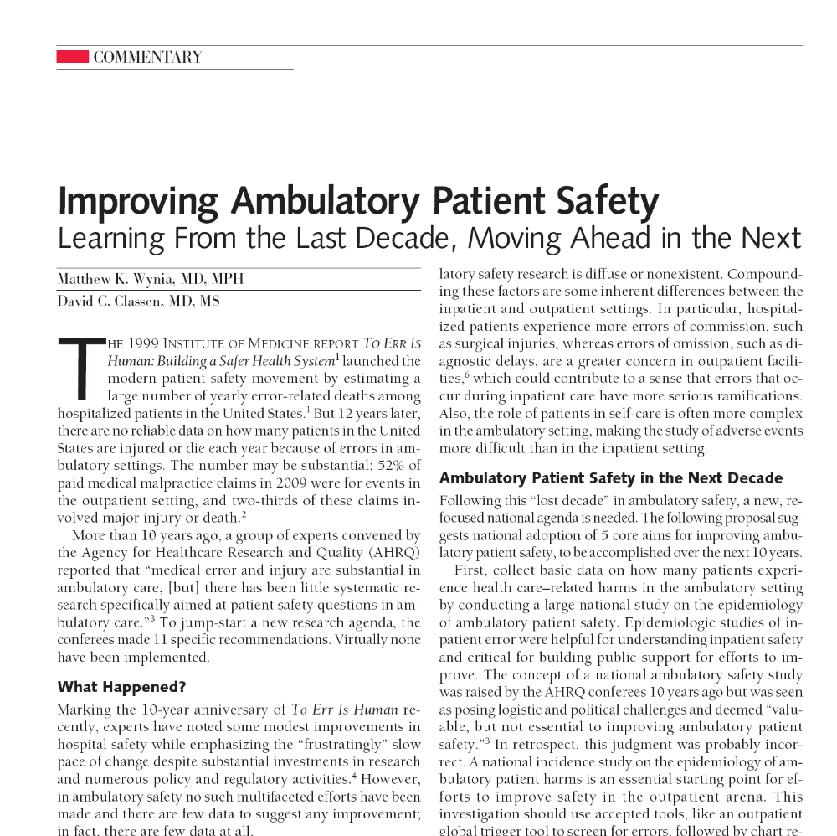
JAMA 12/14/2011

Slide 11
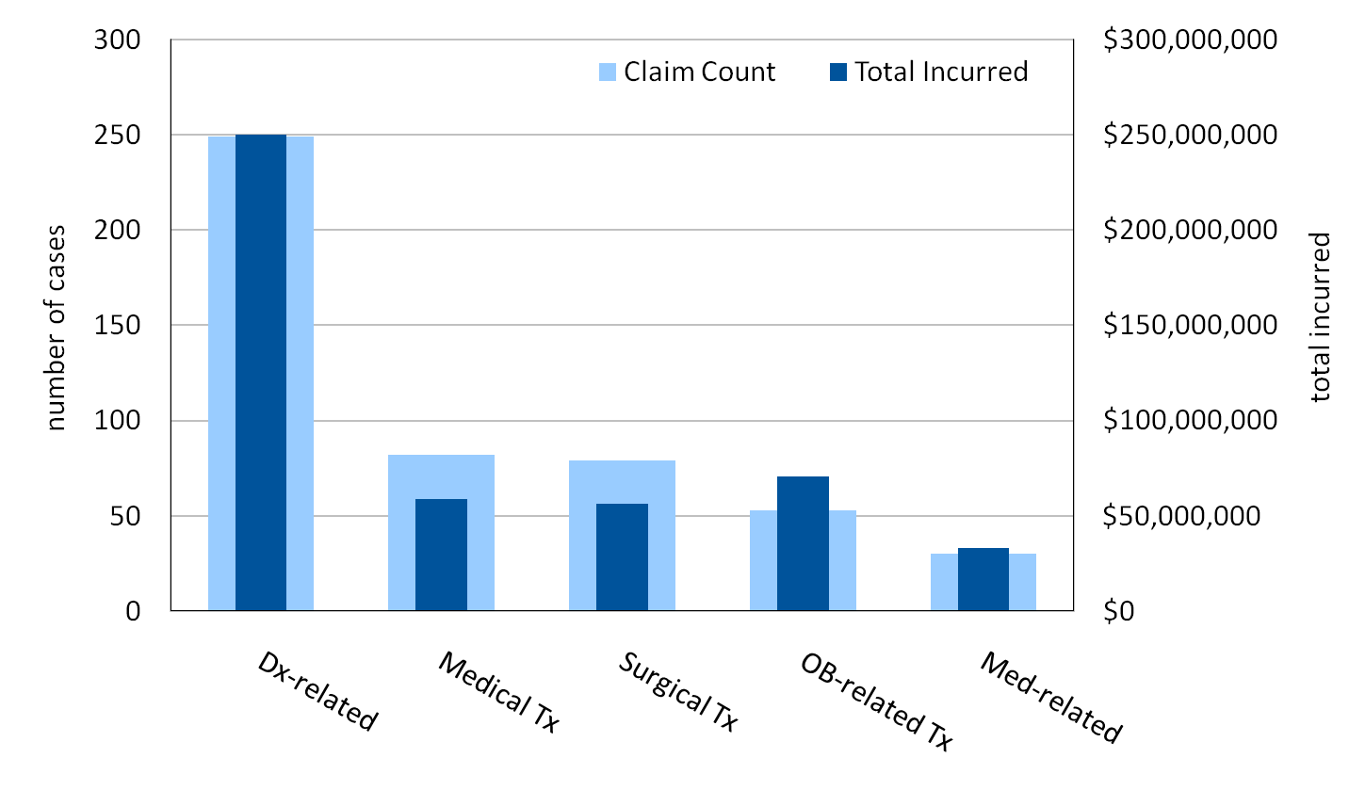
High-severity Cases
Top allegation categories: DIAGNOSIS
N= 543 CRICO PL cases asserted 1/1/04-11/30/09 with a high severity injury.
Total Incurred= reserves on open and payments on closed cases.

Slide 12
High-severity Cases
Diagnostic process of care
step | # cases | % cases | total incurred
1. Patient notes problem and seeks care | 18 | 7% | $16,543,121
2. History/physical and evaluation of symptoms | 118 | 47% | $120,173,820
3. Order of diagnostic/lab tests | 158 | 63% | $160,155,873
4. Performance of tests | 21 | 8% | $18,495,370
5. Interpretation of tests | 82 | 33% | $89,110,234
6. Receipt/transmittal of test results | 35 | 14% | $31,164,644
7. Physician follow up with patient | 62 | 25% | $67,891,064
8. Referral management | 43 | 17% | $40,956,285
9. Patient compliance with follow-up plan | 9 | 4% | $4,288,235
N=249 CRICO PL cases asserted 1/1/04-11/30/09 with a high severity injury and diagnosis-related major allegation.
Notes:
12

Slide 13
Diagnosis claims: case types
Process/Skills Case Type
Diagnostic skills
    Failure to consider a differential diagnosis
    Failure to order additional tests
Diagnostic judgment
    Incorrect interpretation of clinical data
Failure to screen; failure to assess/update history
Failure to receive critical test results
Failure to follow up on abnormal test result
Clinical Case Type
Prostate cancer
Colorectal cancer
Lung
Uterus
Breast cancer
Myocardial infarction
Stroke
Other cancers

Slide 14
Patient safety priorities in ambulatory care
3 key ambulatory safety process areas:
-Test result management
-Referral Management
-Medication Management
Plus Communication issues
14
Notes:
From the literature – the most common contributing problems

Slide 15
The “Big 3” Key Processes
Test ordering & Results Management
  Handling critical results, communication to patient
Follow-up and Referral Management
  Ensuring reliable and timely referrals and f/up for potentially serious problems
Medication Management
  High risk meds, monitoring, CDS,
15

Slide 16
Improved communication:
Domains of improved communication for safer office care
Among practice staff/care team members
Around 3 risk-prone key processes – across settings
  Lab test, referral, medication management
With patients during and between encounters
With patients/families after adverse event
Hearing patients’ concerns and ideas
16
Notes:
Among practice staff/ care team members
Culture of safety elements
Around 3 risk-prone key processes – across settings
Lab test, referral, medication management
With patients during and between encounters
Meeting patient’s needs during the visit - agenda
Shared decision-making; patient literacy/understanding
Working with difficult/challenging patients
With patient/families after adverse event
Hearing patients concerns and ideas
Inputs to improve safety

Slide 17
Overview
Patient safety in Office Practice/Ambulatory Care
Science of Patient Safety: Systems thinking and Safety culture
Effective improvement strategies – the Model for Improvement
The Mount Auburn Practice Improvement Program, built on the successful AHRQ-funded PROMISES program

Slide 18
Science of Patient Safety
Systems thinking
  Design of work processes
Safety culture
  Leadership & values
  Teamwork
  Communication
  Trust, psychological safety

Slide 19
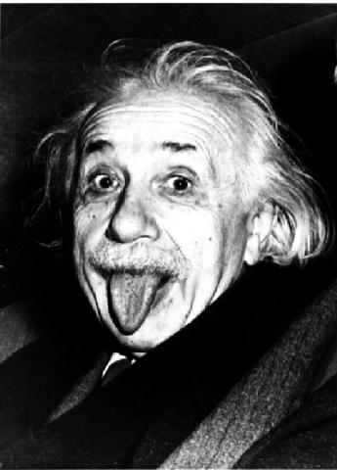
Systems Thinking
Each system is designed to deliver the
results it produces.
Paul Batalden
"The definition of insanity is continuing to do the same thing over and over again and expecting a different result."
Albert Einstein

Slide 20
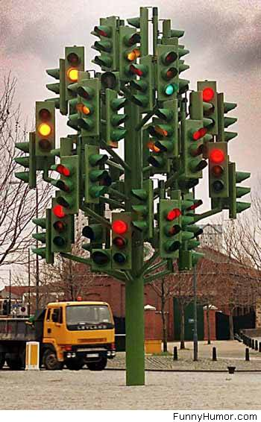
Each system is designed to deliver the results it produces.
P. Batalden
Notes:
Pause -
Don’t worry – it’s just s sculpture, it’s not really supposed to provide signals to the traffic
This one isn’t going to cause error and harm

Slide 21

Notes:
Pause
Bad news – this is supposed to provide signals to the traffic in six lanes–
Complexity here has produced an accident waiting to happen; this is a system design problem
So those are the two core principles for safety
- systems designed for safety and reliability
- culture in which people
work as a team,
listen to each other,
and continually learn and improve
Now- what do we know about how we are doing in healthcare –
What does more recent work show about the level of harm?

Slide 22
A System
A system is a set of interdependent elements interacting to achieve a common aim — a set of things that work together to get to a goal.
A system takes inputs and transforms them into outputs through a process or series of processes.

Slide 23
If we want a new level of performance, we must refine the system
Most problems in organizations do not come from individual workers.
Most problems come from the structure of the systems themselves, and people are only parts of those systems.
Notes:
Changing the people, or pushing them to "try harder" or "do better" will not result in improved performance.

Slide 24
85/15 Rule
85% of problems are system problems and less than 15% are due to workers.
Deming increased that number to more than 94% of problems appear to be system related.
Deming and Juran

Slide 25
Human Error Models
Person model –
  Traditional approach to human error
  “Names, blames, and shames" an individual(s) as "causing" the accident.
  The underlying assumption is that mistakes and errors are the result of negligence, inattention, carelessness, lack of skill or knowledge, lack or motivation or one of a host of other faulty, negative mental processes. This model uses fear and discipline to attempt to improve safety.
  “Bad things happen to bad people."
Notes:
Person Model: This is the traditional approach to human error that "names, blames, and shames" an individual(s) as "causing" the accident. The underlying assumption is that mistakes and errors are the result of negligence, inattention, carelessness, lack of skill or knowledge, lack or motivation or one of a host of other faulty, negative mental processes. This model uses fear and discipline to attempt to improve safety. The person model considers errors as a "moral" issue that "bad things happen to bad people."*

Slide 26
Human Error Models
System model –
  Recognizes that there are systemic contributions to and causes of error.
  Acknowledges that the organizational culture, human-to-system interface design, and environmental elements can create "latent failure" conditions.
  Latent failure conditions contribute to human error.
  The system model recognizes human limitations and that human error is inevitable.
  Systems should be designed to anticipate human error and to mitigate its consequences.

Slide 27
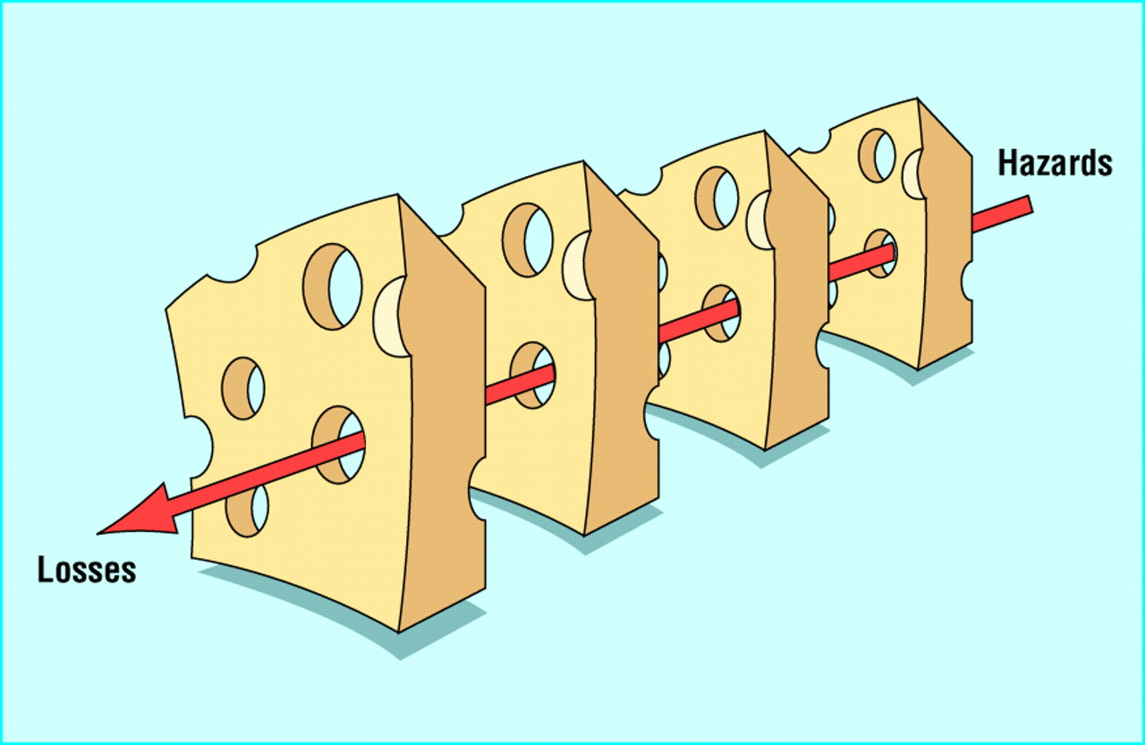
The Swiss Cheese Model of System Accidents
J.Reason, BMJ 2000;320:768-770

Slide 28
System Approaches to Reduce Harm
Prevent Errors
  Through standardization, simplification, forcing functions, etc.
Detect Errors
  Improve methods to identify errors when they occur
  Should not be the primary strategy
Mitigate Harm from Errors
  Prevent error from causing harm
  Mitigate the severity of the harm

Slide 29
Human Factors Engineering
“We can’t change the human condition, but we can change the conditions under which humans work”
James Reason
Notes:
Human factors engineering is the study of how humans interact with systems to achieve desired results

Slide 30
Take a moment to talk to one or two people next to you:
- Think about problems you encounter in your daily work
- Can you identify some of the systems issues that contribute to these problems?

Slide 31
Science of Patient Safety
Systems thinking
Safety culture
What is culture?
“The way we do things around here”

Slide 32
Characteristics of a
Culture of Patient Safety
Driving out fear so people aren’t afraid to ask questions or share things that go wrong
Organizational emphasis on identifying unsafe conditions, taking steps to reduce risks to patients
Ensure that there is learning from mistakes
When dealing with adverse events, replacing blame and fear with learning and improvement.
Recognition that “to err is human”
Leaders model commitment for trust to needed overcome fear and take risks to make change
        Dr. Gordy Schiff
Notes:
Note the attached articles from Steve Spear – stapled into the presentation packet
It is the job of everyone in the practice to look for sources of risk to patients, to bring them to the attention of the team, and to work to fix them, BEFORE they hurt a patient
Look for “accidents waiting to happen”, and change the process to protect patients from harm

Slide 33
“The single greatest impediment to
error prevention in the medical industry is
that we punish people for making mistakes.”
Dr. Lucian Leape
Professor, Harvard School of Public Health

Slide 34
Just Culture
Managing Risk – The Three Behaviors
Normal Error
Reckless Behavior
At-Risk Behavior
Product of our
current
system design
Unintentional risk-taking
Intentional risk-taking
Manage through:
Understanding our at-risk behaviors
Removing incentives for at-risk behaviors
Creating incentives for healthy behavior
Increasing situational awareness
Manage through changes in:
Processes
Procedures
Training
Design
Environment
Manage through:
Disciplinary action
Notes:
As we go through the course, we shall look at three manageable behaviors: 1) normal error 2) at-risk behavior and 3) high-culpability behavior. We will start with the easiest: “normal” or system-induced error.

Slide 35
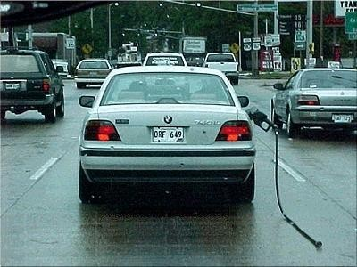
To Err is Human
Notes:
Human error: An inadvertent action; inadvertently doing other than what should have been done, ie slip, lapse, mistake (hit send on email before ready)
Response = console

Slide 36
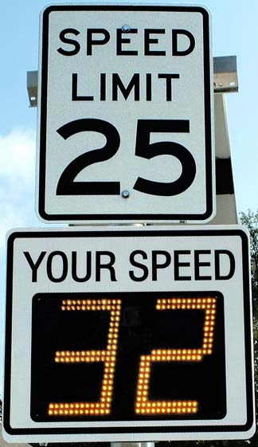
At-Risk Behavior
Notes:
At risk behavior:Behavioral Choice that increases risk usu due to inaccurate risk assessment (ie risk not recognized or mistakenly believed to be justified)
e.g. Drift, cutting corners, short cuts
Response = coaching + improve system if possible to guide behavioral choice to prevent similar error from occurring again

Slide 37

Reckless Behavior
Notes:
Behavioral Choice to consciously disregard a substantial and unjustifiable risk
Response: Punitive or remedial action

Slide 38
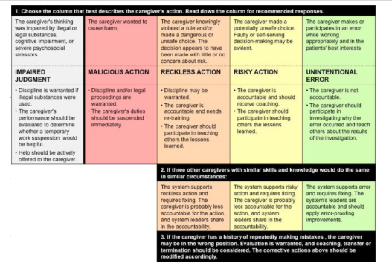
Just Culture

Slide 39
Take a few minutes talking to the person next to you:
In your practice…
Are providers and support staff comfortable talking about errors and near misses at huddles and staff meetings?
Are errors considered a source of learning instead of personal shortcoming?
Do you have experience with Just Culture
Notes:
This does not mean people are not accountable and sometimes responsible. However, errors are a result of poor system design a majority of the time.

Slide 40
Safety Culture Survey
Staff feel like their mistakes are held against them
It is difficult to voice disagreement in this office
Staff are afraid to ask questions when something does not seem right

Slide 41
Staff feel like their mistakes are held against them
Why this is important to improve?
  Fear of blame stops transparency and improvement
  Holding someone accountable is different than blaming
    Accountability implies ethical conduct and effort to improve
How to start the discussion
  Focus on learning from the mistake
  Turn focus toward underlying systems
    Ask how can we create a system that prevents this mistake in the future

Slide 42
It is difficult to voice disagreement in this office
Why this is important to improve?
  Disagreements can lead to better decisions and a more dynamic, learning environment
  Disagreements left unspoken undermine implementation efforts
How to start the discussion
  How can we express opinions in ways that everyone feels heard and respected
  When must we reach agreement; when can we agree to disagree
  Who should be responsible for mediating disagreements

Slide 43
Staff are afraid to ask questions when something does not seem right
Why this is important to improve?
  Possible errors may not be caught
  Learning opportunities are missed
  Staff are left with the impression that something was wrong and ignored
How to start the discussion
  How can we create an environment where asking questions is encouraged and rewarded

Slide 44
Discussing Safety Culture Survey Results Can Help Improve Safety
Teams that used semi-structured debriefing of culture survey results experienced a 10.2% reduction in infection rates
Teams that did not debrief survey results had a 2.2% reduction
    Vigorito, McNicoll, Adams, Sexton. Improving safety culture results in Rhode Island ICUs: lessons learned from the development of action-oriented plans. Jt Comm J Qual Patient Saf. 2011; 37(11): 509-14.

Slide 45
What changes can we make?
Encourage and honor transparency
Implement “just culture”
Develop structured educational programs
Focus on self improvement
Don’t personalize mistakes or corrections
Create an environment that celebrates suggestions and questions
Create a “Speak up” culture—of “no blame”
Improved communications including listening
Have a process to evaluate suggestions
…and many others!!

Slide 46
Overview
Patient safety in Office Practice/Ambulatory Care
Science of Patient Safety: Systems thinking and Safety culture
Effective improvement strategies – the Model for Improvement
The Mount Auburn Practice Improvement Program, built on the successful AHRQ-funded PROMISES program

Slide 47
Some ways not to improve
Try harder (faster, smarter…)
Be more vigilant
Exhortation
Doing things the same way and expecting different results…

Slide 48

Model for Improvement
Aim
Measures
Changes
Developed by: Associates in Process Improvement
Test of Change
The Improvement Guide: A Practical Approach to Enhancing
Organizational Performance, 2nd Ed. Gerald J. Langley et al. Jossey-Bass April 2009
PDSA =
Notes:
Builds on Deming’s Theory and the scientific method
Based on the development, testing and implementing of changes
Heavily focused on learning from small scale tests – “trial-and-learning

Slide 49
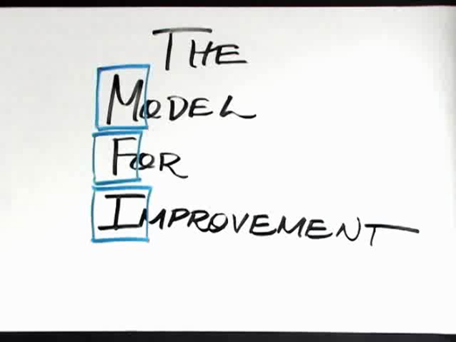
Short Videos
Model for Improvement - Parts 1&2
http://www.youtube.com/watch?feature=player_detailpage&v=SCYghxtioIY

Slide 50
Model for Improvement
Aim
Measures
Changes
Developed by: Associates in Process Improvement
Test of Change
The Improvement Guide: A Practical Approach to Enhancing
Organizational Performance, 2nd Ed. Gerald J. Langley et al. Jossey-Bass April 2009
PDSA =
Notes:
Builds on Deming’s Theory and the scientific method
Based on the development, testing and implementing of changes
Heavily focused on learning from small scale tests – “trial-and-learning

Slide 51
Aims
“It is important that an aim never be defined in terms of activity or methods.
It must always relate directly to how life is better for everyone. . . .
The aim of the system must be clear to everyone in the system. The aim must include plans for the future. The aim is a value judgment.”
W. Edwards Deming

Slide 52
What are we trying to accomplish?
Aim should guide, give focus – “true north”
Use data to help set the aim – what do we know about what we’re trying to improve?
What is it that needs to be improved from the perspective of the customer?
“How much or how good, by when?”
Doesn’t have to be perfect

Slide 53
What would an Aim be for
3 key ambulatory safety process areas:
-Test result management
-Referral Management
-Medication Management
OR
A Communication issue

Slide 54
Model for Improvement
Aim
Measures
Changes
Developed by: Associates in Process Improvement
Test of Change
The Improvement Guide: A Practical Approach to Enhancing
Organizational Performance, 2nd Ed. Gerald J. Langley et al. Jossey-Bass April 2009
PDSA =
Notes:
Builds on Deming’s Theory and the scientific method
Based on the development, testing and implementing of changes
Heavily focused on learning from small scale tests – “trial-and-learning

Slide 55
Measures of Improvement
How will we know that a change is an improvement?
Defining a measure(s) to track the impact of your changes
Balanced set of measures – process, outcome and “balancing” (things you don’t want to see worsening as a result of changes made)
Some measures will only be used during testing (PDSA measures), others will track over time

Slide 56
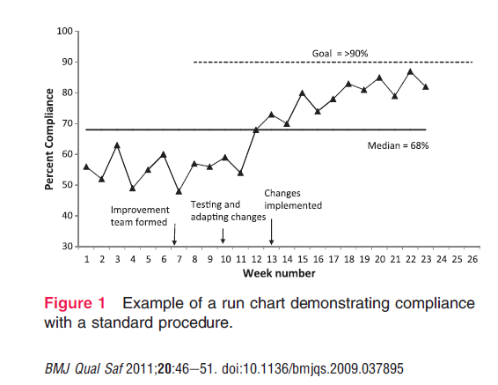
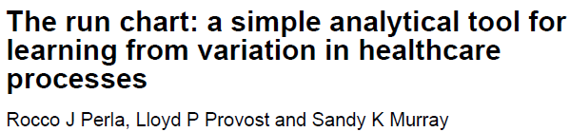
Measurement over time
http://www.ihi.org/knowledge/Pages/Publications/TheRunChartASimpleAnalyticalToolforLearningfromVariationHealthcareProcesses.aspx

Slide 57

What do Angry Birds have to do with this?
Iterative testing cycles
Using prediction and data from prior tests to plan and execute the next tests
Can learn as much or more from tests that “don’t work”
Notes:
Yes – Angry Birds involves flinging things (intially angry birds) from a slingshot that you pull back and aim, to destroy – usually a pig/pigs in a structure of some sort…..but the iterative part is getting the trajectory right….

Slide 58
Model for Improvement
Aim
Measures
Changes
Developed by: Associates in Process Improvement
Test of Change
The Improvement Guide: A Practical Approach to Enhancing
Organizational Performance, 2nd Ed. Gerald J. Langley et al. Jossey-Bass April 2009
PDSA =
Notes:
Builds on Deming’s Theory and the scientific method
Based on the development, testing and implementing of changes
Heavily focused on learning from small scale tests – “trial-and-learning

Slide 59
Changes
What changes can we make that will result in improvement?
Team that knows/describes the current process
Consider ideas that might improve the process – standardize, reduce reliance on memory, simplify, improve communication

Slide 60
Tests of Change: The PDSA Cycle for
Learning and Improvement
Act
Plan
Adapt?
Adopt?
Abandon?
What’s the
next cycle?
Objective Questions
& predictions (why).
Plan to carry out cycle
(who/what/where/when).
Next cycle?
Study
Do
Complete the
analysis of the data.
  Compare data to
  Predictions.
    Summarize what
    was learned.
Carry out the plan
(on a small scale).
Document problems
and unexpected
observations.
Begin analysis.
W.E. Deming referred to this as the Shewhart Cycle
Notes:
Using small scale tests of change to build knowledge and confidence in changes that you want to make permanent (it’s not that the changes you want to make are small, but you start your testing on a small scale – one patient, one day etc)
Using prediction and data to add rigor to the learning

Slide 61
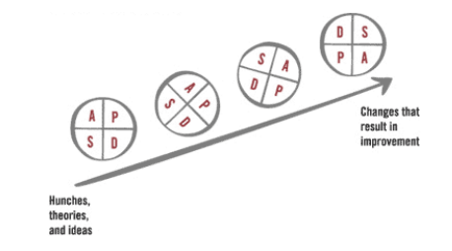
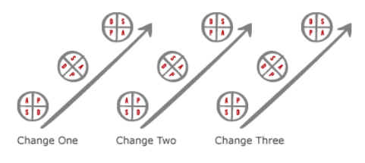
Iterative Cycles of Change
Notes:
Cycles done under different conditions and at expanding scale to help zero in on the change you will implement (make permanent)
When you’re working on multiple changes (like the 3+1), you will be testing in an number of areas at once

Slide 62
Overview
Patient safety in Office Practice/Ambulatory Care
Science of Patient Safety: Systems thinking and Safety culture
Effective improvement strategies – the Model for Improvement
The Mount Auburn Practice Improvement Program, built on the successful AHRQ-funded PROMISES program

Slide 63
Mount Auburn
Ambulatory Patient Safety Program
CRICO funded – Ambulatory Patient Safety program – system for reporting, learning, and sharing learning
Mount Auburn Practice Improvement Program
( MA-PIP) to train practice clinicians and staff to
  understand principles of safety science
  see problems and solve problems
Built on the successful AHRQ-funded PROMISES program
Notes:
Paula Griswold will explain the PROMISES project

Slide 64
PROMISES
Proactive Reduction in Outpatient Malpractice:
Improving Safety, Efficiency and Satisfaction
Paula Griswold
Executive Director
Massachusetts Coalition for the Prevention of Medical Errors

Slide 65
PROMISES was a test
PROMISES gave us the opportunity to test the idea that
even small primary care practices,
with few resources to support change,
can learn the skills and techniques to implement a patient safety program, and
ultimately use that learning to support other improvement work.
  The PROMISES (Proactive Reduction of Outpatient Malpractice: Improving Safety, Efficiency, and Satisfaction) Project was supported by grant number R18HS019508 from the Agency for Healthcare Research and Quality. The content is solely the responsibility of the authors and does not necessarily represent the official views of AHRQ
Notes:
Explain Proactive Reduction in Outpatient Malpractice; Improving Safety, Efficiency and Satisfaction

Slide 66
Focus areas in PROMISES
Patient Safety Principles and topics
  3 priority processes:
      Test result management
      Referral management
      Medication Management
  Communication – with patients & among staff
  Reduce wasted time
Quality Improvement techniques

Slide 67
PROMISES Activities
Taught improvement techniques in webinars to improvement teams in the practice
Coaches helped teams implement the approach
  Identify problems, understand causes
  Small tests of possible solutions
  Measure/assess results
Community learning sessions to share results among the teams

Slide 68
Key learning from PROMISES
PROMISES demonstrated:
  The importance of coaches
  The power of community learning sessions
  The critical role of practice managers
  The value of small tests of change
  The importance of a physician champion
Notes:
The importance of coaches to develop the skills of practice staff to apply the techniques in their own offices.
The power of community learning sessions to reinforce and support the experience of practice staff by offering opportunities to share with and learn from staff from other office practices
The critical role of practice managers in the leadership, ongoing discipline, and internal coordination of improvement work
The value of small tests of change to a practice’s ability to manage improvement work while they continue to care for their patients.
The importance of a physician champion

Slide 69
PROMISES Results:
Exit Interviews
“Before [PROMISES], … my whole time was spent just putting out fires, not really dealing with what is causing the fires… and now, since PROMISES, my whole approach to it is, "okay let's deal with the immediacy of the problem, but let's look further into how we can prevent this from happening again.”
“The PROMISES program works. Attacking it in small fundamental bites, and mapping out the process, and finding out where the actual problems are, is a process that I hope everyone learns.”
“As we did it piece by piece… it really wasn't a lot of time and the changes we made were so significant…”
“So with [coaches] prompting us, keeping in touch with us, and challenging us as to why we are doing this and all of their support in little slices rather than, ‘here you go, boil the ocean.’”

Slide 70
PROMISES Results:
Exit Interviews
“Seeing all the practices, and having somebody ask the same question that you might have been thinking, was extremely valuable”
"I think the number one [benefit] was being more aware of the fact that there are areas to change, and number two was this idea of small tests of change can start small. And number three is going back and looking at the change, measuring it and testing it by asking -- did your hypothesis actually work?"
"We were able to conquer things that we did not even know existed... that is so wonderful and important in my practice, and I am so grateful for it.”
“When you look back now, you think, ‘how did we not do that 18 months ago?’”
“...it was incredibly helpful”

Slide 71
PROMISES Results: Chart Review
Data abstraction tool based on CRICO/Coverys Office Practice Evaluation chart audit tool
Collect information about:
  Turnaround times
  Documentation and completion of plans
  Patient notification
  Medication safety and management
  High Risk Referral
71

Slide 72
Chart Review:
Identifying Charts
Results that Flag Charts
PSA > 5.0
TSH > 10
INR > 4.0
Cr > 1.8
K⁺ > 5.4
Practice or lab vendor identifies charts with high test results
Other Critical Tests
Guaiac Positive Stool
Abnormal Mammogram
Abnormal PAP
Pulmonary Nodule
Abdominal Mass
Abnormal Colonoscopy
High-Risk Referrals
Tests with suspicious results for Breast, Prostate, Colon, Ovarian or Skin Cancer
Notes:
PROMISES team asks practice to identify charts with one or more high test results in a six-month window
Practice identifies up to 100 patient charts either through their lab vendor (such as Quest) or using their own EMR
Results that Flag Charts
PSA > 5.0
TSH > 10
INR > 4.0
Cr > 1.8
K+ > 5.4
Once charts are identified, they are reviewed for these and other high risk test results and referrals during a one-year window

Slide 73
Chart Review:
Review Criteria
Questions for
Abnormal
Test Results
Questions for
High-Risk
Referrals
Questions for
Medication
Safety
Test Value?
Date in Chart?
Abnormality Noted?
Action/Referral Plan Noted?
Patient Notification?
Treatment Plan Completed?
Specialty?
Reason for Referral?
Returned Consult in Chart?
PCP Acknowledgement?
Action on Specialist Recommendations?
If on Warfarin:
  Using NSAID?
If Creatinine > 1.8
  Using nephrotoxic drugs?
Allergies or NKDA listed?
Notes:
What is the test result value and date?
Is the abnormal test result in the chart?
Is the abnormality noted by the responsible provider?
Is there an action or referral plan documented?
Is notification of the patient documented?
Is there evidence that treatment was completed?
What is the referral specialty and date?
What is the reason for the referral?
Is the returned consultation in the chart?
Is there evidence that the referring clinician acknowledged the consult recommendations?
Is there evidence of action on recommendations?

Slide 74
Chart Review:
Pre-intervention Statistics
815 charts reviewed across 16 practices
51 charts reviewed on average per site
29.2% (475) of the abnormal test results identified contained at least one critical documentation failure, as did 52.1% (38) of high-risk referrals
A total of 126 potential adverse events were found, with 27 deemed sufficiently serious enough to warrant provider notification

Slide 75
PROMISES Chart Review Results:
Number of Potential Adverse Events
(no follow up of abnormal tests or medication values, high risk referrals)
68% reduction
Notes:
Statistically significant results from chart reviews demonstrated effectiveness.
Pre-intervention chart reviews in 16 PROMISES practices found 126 potential adverse events*
Dropped to 41 after the PROMISES program, a nearly 70% reduction
*failure to follow up or document a follow up of an abnormal test result or referral to a specialist that could have resulted in an adverse event)

Slide 76
PROMISES Chart Review Results:
Number of Serious Potential Adverse Events*
57% reduction
* Attached handout defines Serious Potential Adverse Events
Notes:
Chart reviews showed a 57% reduction in serious potential adverse events ** from 23 instances to 10, after the PROMISES intervention
** when failure to follow up could have resulted in a serious clinical outcome

Slide 77
Our Mount Auburn
Practice Improvement Program ( MA-PIP)
Builds on the PROMISES learning
Supported by the state Health Care Workforce Training Fund
  to train front line health care workforce in skills needed to implement and deal with the demands of health care reform
A collaboration to build a quality improvement infrastructure within Mount Auburn, including
  trained, experienced coaches and practice managers,
  a dynamic learning environment for office practices

Slide 78
Mount Auburn
Practice Improvement Program
Two year partnership built on PROMISES:
  Teach practice leaders and staff techniques to make care safer - through more reliable processes, better communication, less wasted time
Train practice managers/clinicians/staff in patient safety principles, quality improvement techniques
  Video learning modules & webinars/meetings
  Community Learning Sessions for clinicians and staff
Train two MAPS directors as coaches to work with teams from selected Mount Auburn office practices to practice these approaches
  Start with two practices
  Expand over time
Notes:
Builds on the PROMISES learning
A collaboration to build a quality improvement infrastructure within Mount Auburn
Trained coaches ( Sonya Sullivan, Susan McDonnell working directly with practices – also Lora Gross-Kostka)
Trained practice managers
Create an ongoing learning environment for MAPS & MACIPA practices
As we work together - will discuss INTEGRATION WITH OTHER PROGRAM _ ONE PATIENT SAFETY PROGRAM

Slide 79
What training is provided
 | 14 Learning Modules | Webinars to reinforce learning | Community Learning Sessions | Coaching for Practice Improvement Teams
All MAPS & MACIPA practices | X | X | X
Selected Practices | X | X | X | X

Slide 80
Our Goals
All participants will learn the principles of patient safety and techniques of quality improvement
Coaches will have the skills necessary to teach and support improvement teams
Improvement teams in the practices will use quality improvement techniques in their daily work:
  conduct small tests of change, measure for improvement and select successful changes for implementation
Mount Auburn will maintain and expand the approach and activities used during this project

Slide 81
Questions?

